Slide 1
Bayesian Methods 101: Background
PyData Calgary
March 4, 2020

Slide 2
Review: Goals of Inferential Statistics
Parameter Estimation
Distributions parameters, regression coefficients
Model how the data is generated
Data Prediction
What is possible/likely to expect in the future?
Model Selection
AIC/BIC, analysis of residuals
Which option of these models is the most reliable?

Slide 3
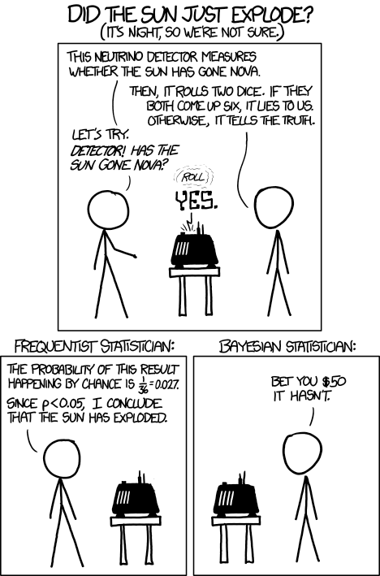
1.
Comparison: Frequentists and Bayesians

Slide 4
Bayesian and Frequentist
Worldview
Probability as frequency
vs logic
Frequentist (Classical)
Probabilities are long term average frequencies
“I know that there is an underlying distribution to this data, but I don’t know what it is. I’ll observe events, and then determine the most likely settings after having seen the data.
Estimation is typically maximum likelihood
Point estimates
Random control trials, p-tests
Bayesian
Express degrees of belief as probabilities
“I have a hypothesis about how the world works. I observe some new evidence which is potentially at odds with my model. Should I update my beliefs?
Focused on updating beliefs (priors) as new information becomes available
Estimates as distributions

Slide 5
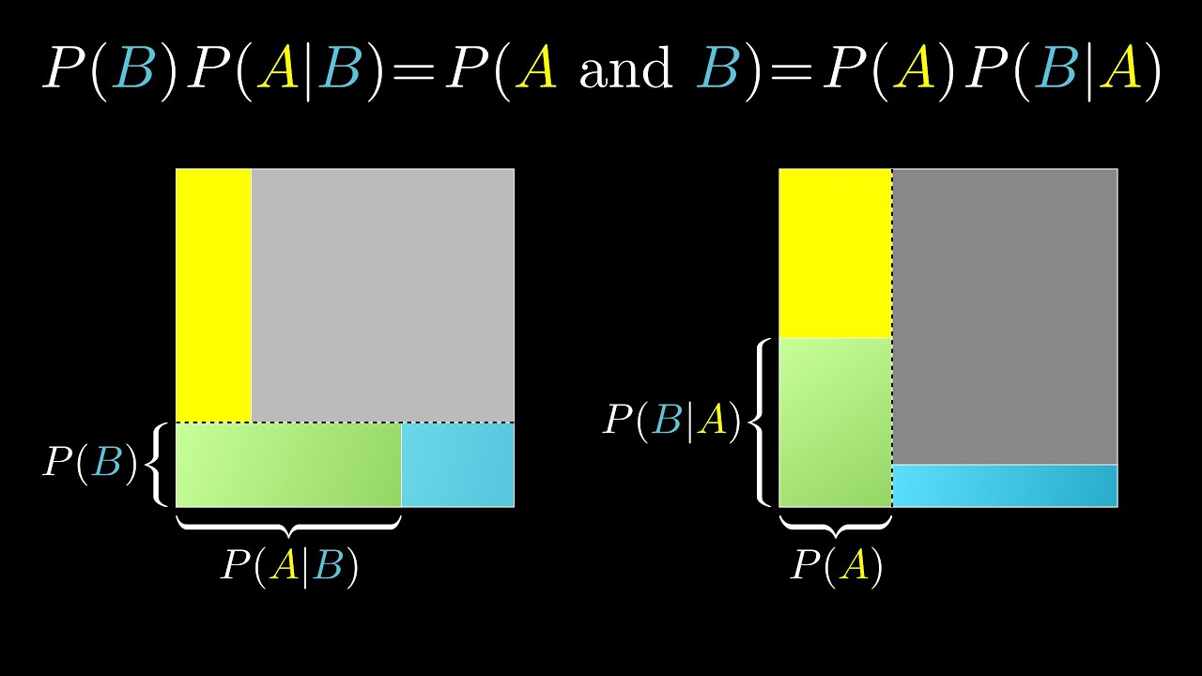
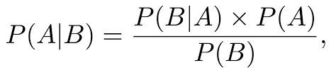
Bayes Theorem Demo
Intuitive Interactive Bayes' Theorem Visualization
Notes:
Tea and scones! If I tell you that ⅔ of the people who come to the coffee shop and order tea, and 1/2 of those who order tea also order a scone, how many people order tea and scones? Well, the order of information doesn’t matter. I could have told you how many people order scones (5/12) first and then the number who also order tea (⅘), and you would have worked out the exact same quantity. That is all Bayes theorem is.
The reason it’s so useful is that for some directions, probability is intuitive and easy to calculate. However, going backwards can be hazy and difficult for humans to intuit. Bayes theorem gives us a mathematical tool we can use to work out the probabilities when our intuition fails.

Slide 6
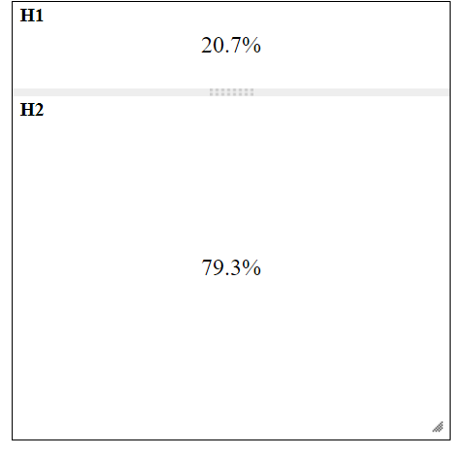
Snowy
Sunny

Slide 7
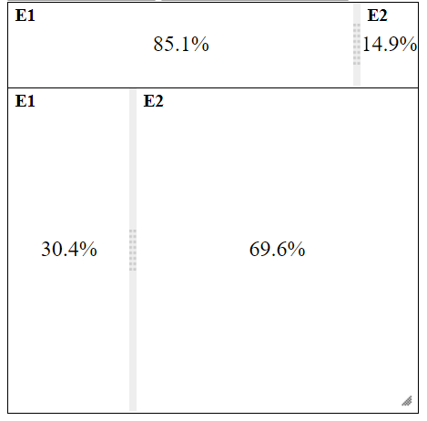
Snowy
Toque
Snowy + No Toque
Toque
No Toque
Sunny
Sunny

Slide 8
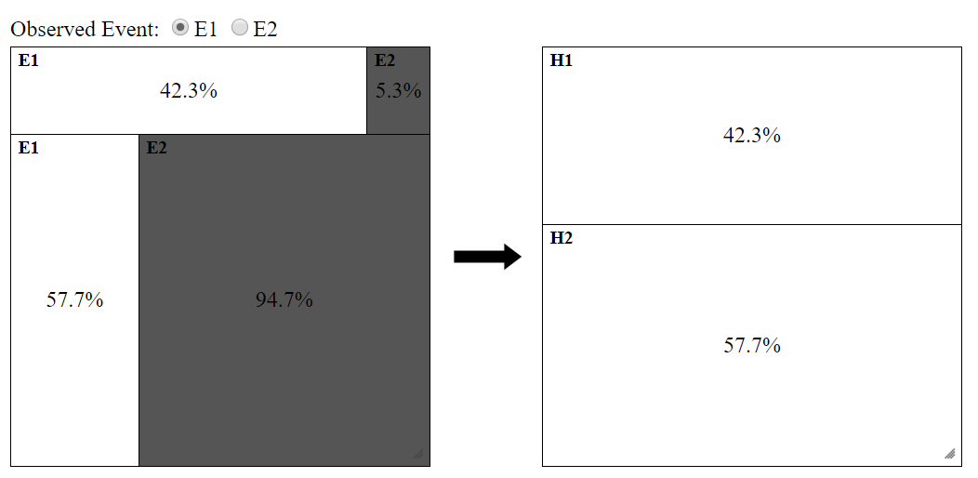
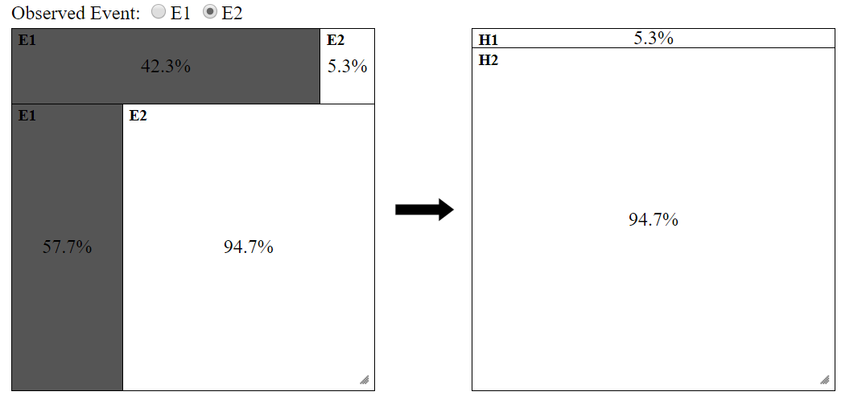

Slide 9
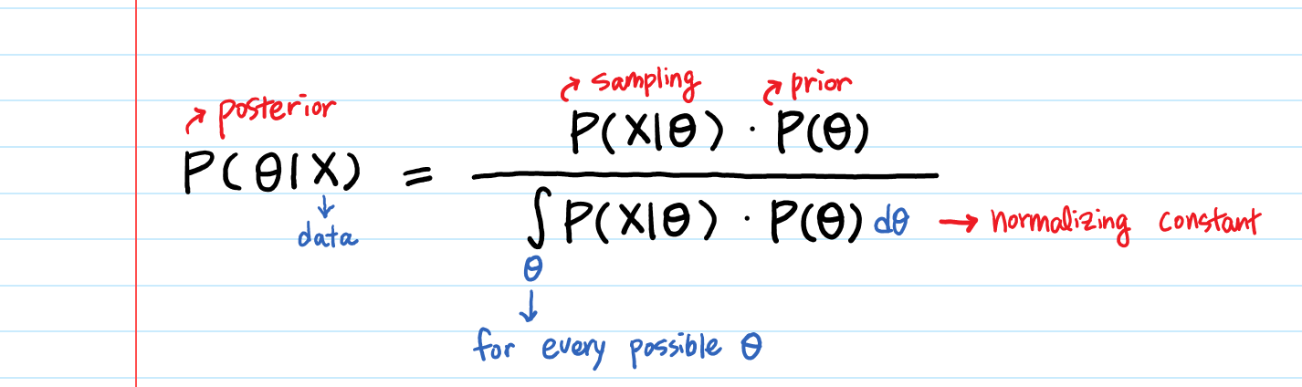
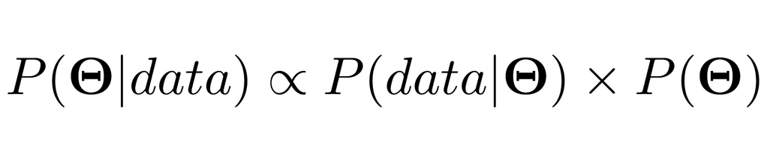
Bayesian Inference
Θ is prior
P(data | Θ) is our likelihood distribution
We only care about maximizing P(Θ | data)
P(Θ | data) calculated computationally or analytically

Slide 10
The core of Bayesian Inference is to combine two different distributions (likelihood and prior) into one “smarter” distribution (posterior)

Slide 11
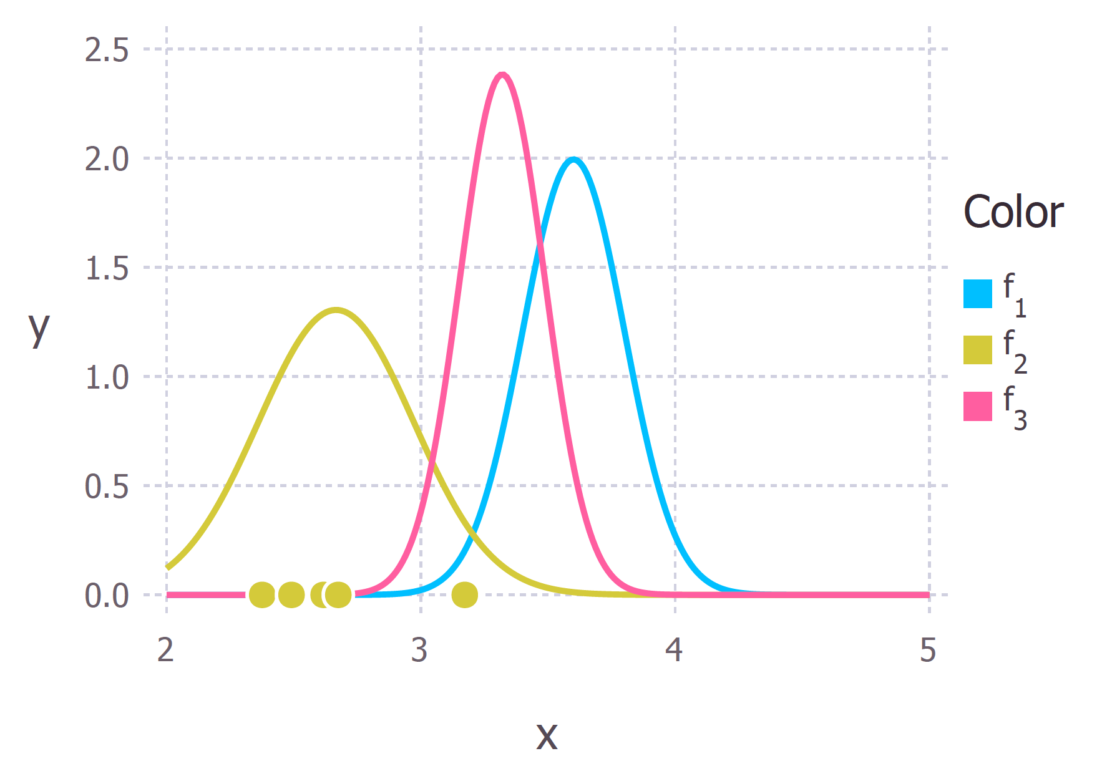
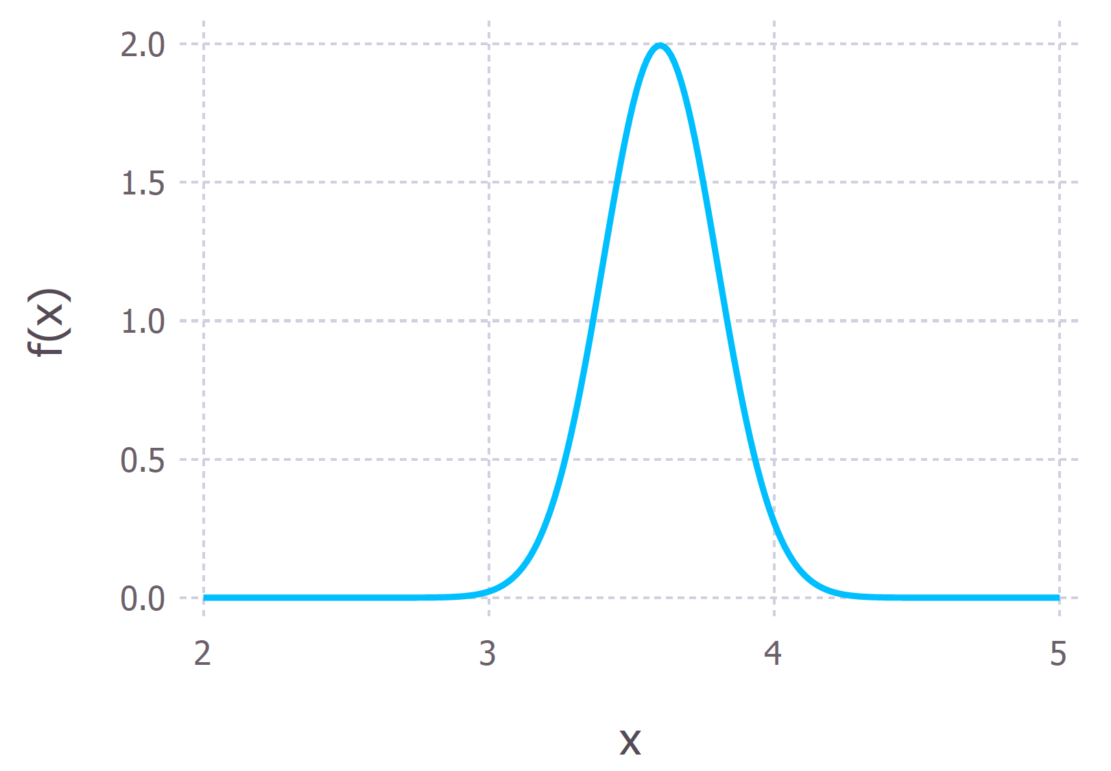
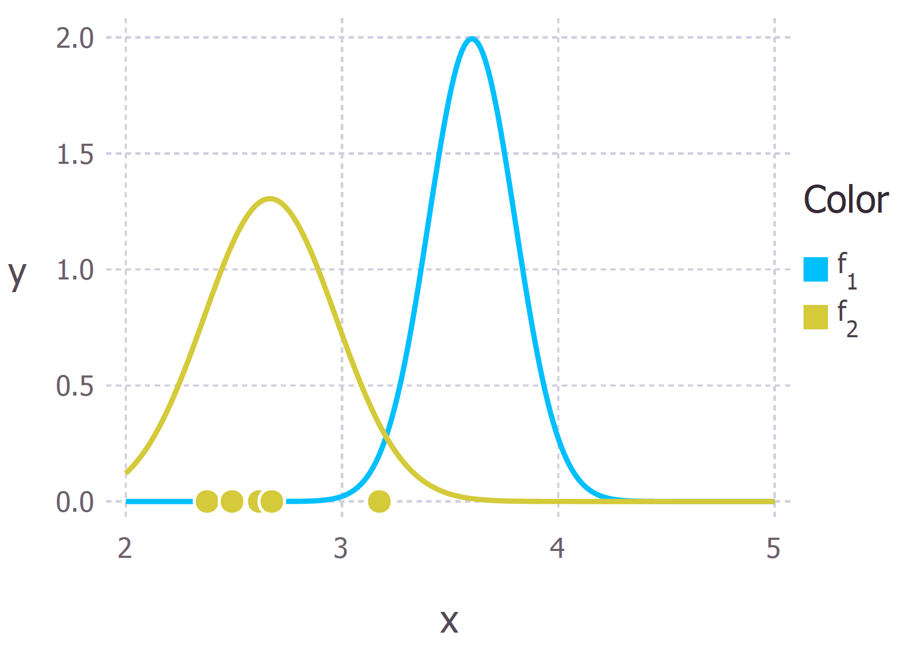
Bayesian Inference:
Conceptual Example

Slide 12
Why are Bayesian Statistics Useful?
More intuitive
Requires less data
One observation is enough to be used
Incorporate prior knowledge or first-principles reasoning
Clearly state your assumptions
For generative processes, we specify a data generation process
Typically communicates better to non-technical individuals
Notes:
To call yourself a data scientist, science implies creat

Slide 13
Code Example: Working with Bayes
https://colab.research.google.com/drive/1CgRWq6sScIBKp-2k5_CtVFrwo0s0KAAH

Slide 14
Next Time:
Probablistic Computation Techniques and Markov Chain Monte Carlo

Slide 15
Sample sizes are never large. If N is too small to get a sufficiently-precise estimate, you need to get more data (or make more assumptions). But once N is "large enough," you can start subdividing the data to learn more (for example, in a public opinion poll, once you have a good estimate for the entire country, you can estimate among men and women, northerners and southerners, different age groups, etc.). N is never enough because if it were "enough" you'd already be on to the next problem for which you need more data.
Andrew Gelman

Slide 16
Laboratory: Bayesian Methods for Hackers
https://colab.research.google.com/drive/12Smgx2q0zbe4HwWBpk1BgS9ls5q8FeiM

